Slide 1
Apache Spark on Azure HDInsight A technical overview Nishant Thacker Microsoft

Slide 2

Spark on HDInsight
Agenda
Apache Spark Overview
Apache Technical Overview
Spark SQL
Spark Streaming
Spark ML
Azure HDInsight Spark

Slide 3
Apache Spark Overview
Agenda
Overview
Benefits
Unified Platform
Use Cases
Spark and Hadoop
Performance

Slide 4
Apache Spark – An Unified Framework
An unified, open source, parallel, data processing framework for Big Data Analytics
Spark SQL
Interactive Queries
Spark Streaming
Stream processing
Spark MLlib
Machine Learning
GraphX
Graph Computation
Spark Unifies:
Batch Processing
Real-time processing
Stream Analytics
Machine Learning
Interactive SQL
Spark Core Engine
Yarn
Mesos
Standalone Scheduler

Slide 5
Spark - Benefits
Performance
Using in-memory computing, Spark is considerably faster than Hadoop (100x in some tests).
Can be used for batch and real-time data processing.
Developer Productivity
Easy-to-use APIs for processing large datasets.
Includes 100+ operators for transforming.
Unified Engine
Integrated framework includes higher-level libraries for interactive SQL queries, processing streaming data, machine learning and graph processing.
A single application can combine all types of processing
Ecosystem
Spark has built-in support for many data sources such as HDFS, RDBMS, S3, Apache Hive, Cassandra and MongoDB.
Runs on top the Apache YARN resource manager.

Slide 6
Advantages of Unified Platform
Input Streams of Events
Improves developer productivity—single consistent set of APIs
All different systems in Spark share the same abstraction – RDDs (Resilient Distributed Datasets).
So can mix and match different kind of processing in the same application. This is a common requirement for many big data pipelines
Performance improves because unnecessary movement of data across engines is eliminated
Spark Streaming
Machine Learning
Spark SQL
In many pipelines, data exchange between engines is the dominant cost.
NoSQL DB

Slide 7
Spark – Use cases
Use case | Description | Users
Data Integration and ETL | Cleansing and combining data from diverse sources | Palantir: Data analytics platform
Interactive analytics | Gain insight from massive data sets tin ad hoc investigations or regularly planned dashboards. | Goldman Sachs: Analytics platform Huawei: Query platform in the telecom sector.
High performance batch computation | Run complex algorithms against large scale data | Novartis: Genomic Research MyFitnessPal: Process food data
Machine Learning | Predict outcomes to make decisions based on input data | Alibaba: Marketplace Analysis Spotify: Music Recommendation
Real-time stream processing | Capturing and processing data continuously with low latency and high reliability | Netflix: Recommendation Engine British Gas: Connected Homes

Slide 8
Spark integrates well with Hadoop
Spark can use Hadoop 1.0 or Hadoop YARN as resource managers.
Spark also can work with other resource managers:
MESOS
It’s own resource manager
Spark does not have it own storage layer. Spark can read and write directly to HDFS.
Integrates with Hadoop ecosystem projects such as Apache Hive, Apache HBase.

Slide 9
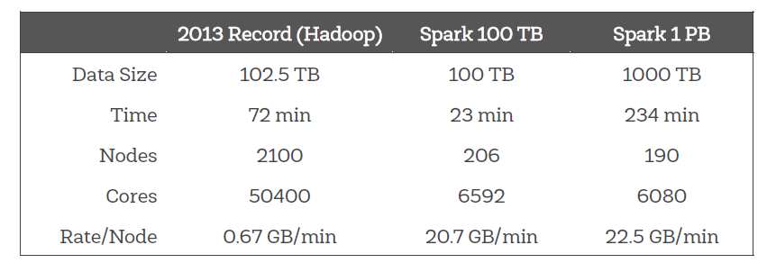
Spark is fast
Spark is the current (2014) Sort Benchmark winner.
3x faster than 2013 winner (Hadoop).
Spark is fast not just for In-Memory but On-Disk computation as well
tinyurl.com/spark-sort

Slide 10
… especially for iterative applications
140
In iterative applications the same data is accessed repeatedly often in a sequence.
Most machine learning algorithms and streaming applications (that maintain aggregate) state are iterative in nature.
120
Hadoop
100
80
Running Time(s)
60
40
20
Spark
0
0.9
Logistic Regression
Logistic regression on a 100-node cluster with 100 GB of data
Notes:
points = spark.textFile(...).map(parsePoint).cache() w = numpy.random.ranf(size = D) # current separating plane for i in range(ITERATIONS): gradient = points.map( lambda p: (1 / (1 + exp(-p.y*(w.dot(p.x)))) - 1) * p.y * p.x ).reduce(lambda a, b: a + b) w -= gradient print "Final separating plane: %s" % w

Slide 11
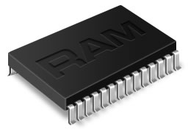
What makes Spark fast?
Spark provides primitives for in-memory cluster computing. A Spark job can load and cache data into memory and query it repeatedly (iteratively) much quicker than disk-based systems.
Spark integrates into the Scala programming language, letting you manipulate distributed datasets like local collections. No need to structure everything as map and reduce operations
Data-sharing between operations is faster as data is in-memory:
In Hadoop data is shared through HDFS which is expensive. HDFS maintains three replicas.
Spark stores data in-memory without any replication.
Data Sharing between Steps of a Job
Read from HDFS
Write to HDFS
Read from HDFS
Write to HDFS
In Traditional MapReduce
Step 1
Step 2
Read from HDFS
In Spark
Step 1
Step 2

Slide 12
Spark
Concepts
Agenda
Cluster Architecture
RDD Abstraction
RDD operations
Accumulators

Slide 13
Spark Cluster Architecture
Driver Program SparkContext
‘Driver’ runs the user’s ‘main’ function and executes the various parallel operations on the worker nodes.
The results of the operations are collected by the driver
The worker nodes read and write data from/to HDFS.
Worker node also cache transformed data in memory as RDDs
Cluster Manager
Worker Node
Worker Node
Worker Node
Cache
Cache
Cache
Task
Task
Task
Read
Read
Read
HDFS

Slide 14
Spark Cluster Architecture - Driver
The driver performs the following:
connects to a cluster manager to allocate resources across applications
acquires executors on cluster nodes – processes run compute tasks, cache data
sends app code to the executors
sends tasks for the executors to run
Driver Program SparkContext
Cluster Manager
Worker Node
Worker Node
Worker Node
Cache
Cache
Cache
Task
Task
Task
Executor
Executor
Executor

Slide 15
Core Abstraction: Resilient Data Sets (RDDs)
The primary abstraction in Spark. A fault-tolerant collection of elements stored in memory or on disk that can be operated on in parallel
Two types:
Parallelized collection: Apply a parallel transformation to an existing Scala collection. Have to specify the number of partitions.
Hadoop dataset: run functions on each record of a file in Hadoop distributed file system or any other storage system supported by Hadoop
Can be persisted in memory across operations. When an RDD is persisted each node stores any partitions of it that it compute in memory and then reuses them in other actions on the dataset.
Can mark a RDD as persistent just by calling the persist() or cache() method.
Can specify the storage level: on disk, in-memory, as serialized Java object etc.
Cached or persistent RDDs are fault tolerant without replication
Each RDD maintains its lineage i.e. the sequence of transformations that resulted in the RDD.
If an RDD is lost because a node crashed, it can be reconstructed by replaying the sequence of operations.

Slide 16
RDDs: Transformations and Actions
RDDs support two types of operations: Transformation and Actions
Transformations create an new dataset from an existing dataset
All transformations are lazy: they do not compute their results right away. The transformations are only computed when an action requires a result to be returned to the driver program. Obviously does not apply to persistent RDDs.
map, filter, sample, union, … [See appendix for full list]
Actions return a value to the driver program after running a computation on the dataset.
Example: reduce, collect, count, first, foreach, etc. [See appendix for full list]
RDD
RDD
Value
transformations
RDD
actions
RDD
RDD

Slide 17
Transformations and Actions: Sample Code
Sample code to search through error messages in a log file (stored in HDFS)
val file = spark.textFile("hdfs://...")
val errors = file.filter(line => line.contains("ERROR"))
//Cache errors
errors.cache()
// Count all the errors
errors.count()
// Count errors mentioning MySQL
errors.filter(line => line.contains(“Web")).count()
// Fetch the MySQL errors as an array of strings
errors.filter(line => line.contains(“Error")).collect()
Transformation: hdfs(), filter()
Action: count(), collect()
Cache() is a method

Slide 18
RDD Transformations (1)
Transformation | Description
map(func) | return a new distributed dataset formed by passing each element of the source through a function func
filter(func) | return a new dataset formed by selecting those elements of the source on which func returns true
flatmap(func) | similar to map, but each input item can be mapped to 0 or more output items (so func should return a Seq rather than a single item)
sample(withReplacement, fraction, seed) | sample a fraction of the data, with or without replacement, using a given random number generator seed
union(otherDataset) | return a new dataset that contains the union of the elements in the source dataset and the argument
distinct(([numTasks])) | return a new dataset that contains the distinct elements of the source dataset

Slide 19
RDD Transformations (2)
Transformation | Description
groupBykey([numTasks]) | when called on a dataset of (K, V) pairs, returns a dataset of (K, Seq[V]) pairs
reduceByKey(func, [numTasks]) | when called on a dataset of (K, V) pairs, returns a dataset of (K, V) pairs where the values for each key are aggregated using the given reduce function
sortByKey([ascending], [numTasks]) | when called on a dataset of (K, V) pairs where K implements Ordered, returns a dataset of (K, V) pairs sorted by keys in ascending or descending order, as specified in the boolean ascending argument
join(otherDataset, [numTasks]) | when called on datasets of type (K, V) and (K, W), returns a dataset of (K, (V, W)) pairs with all pairs of elements for each key
cogroup(otherDataset, [numTasks]) | when called on datasets of type (K, V) and (K, W), returns a dataset of (K, Seq[V], Seq[W]) tuples – also called groupWith
cartesian(otherDataset) | when called on datasets of types T and U, returns a dataset of (T, U) pairs (all pairs of elements)

Slide 20
RDD Actions (1)
Action | Description
saveAsTextFile(path) | write the elements of the dataset as a text file (or set of text files) in a given directory in the local filesystem, HDFS or any other Hadoop-supported file system. Spark will call toString on each element to convert it to a line of text in the file
saveAsSequenceFile(path) | write the elements of the dataset as a Hadoop SequenceFile in a given path in the local filesystem, HDFS or any other Hadoop-supported file system. Only available on RDDs of key-value pairs that either implement Hadoop's Writable interface or are implicitly convertible to Writable (Spark includes conversions for basic types like Int, Double, String, etc).
countByKey() | only available on RDDs of type (K, V). Returns a `Map` of (K, Int) pairs with the count of each key
foreach(func) | run a function func on each element of the dataset –usually done for side effects such as updating an accumulator

Slide 21
RDD Actions(2)
Action | Description
reduce(func) | aggregate the elements of the dataset using a function func (which takes two arguments and returns one), and should also be commutative and associative so that it can be computed correctly in parallel
collect() | return all the elements of the dataset as an array at the driver program – usually useful after a filter or other operation that returns a sufficiently small subset of the data
first() | return the first element of the dataset – similar to take(1)
count() | return the number of elements in the dataset
take(n) | return an array with the first n elements of the dataset – currently not executed in parallel, instead the driver program computes all the elements
takeSample (withReplacement, fraction, seed) | return an array with a random sample of num elements of the dataset, with or without replacement, using the given random number generator seed

Slide 22
RDD Persistence Options
Storage Level | Meaning
MEMORY_ONLY | Store RDD as deserialized Java objects in the JVM. If the RDD does not fit in memory, some partitions will not be cached and will be recomputed on the fly each time they're needed. This is the default level.
MEMORY_AND_DISK | Store RDD as deserialized Java objects in the JVM. If the RDD does not fit in memory, store the partitions that don't fit on disk, and read them from there when they're needed.
MEMORY_ONLY_SER | Store RDD as serialized Java objects (one byte array per partition). This is generally more space-efficient than deserialized objects, especially when using a fast serializer, but more CPU-intensive to read.
MEMORY_AND_DISK_SER | Similar to MEMORY_ONLY_SER, but spill partitions that don't fit in memory to disk instead of recomputing them on the fly each time they're needed.
DISK_ONLY | Store the RDD partitions only on disk.
MEMORY_ONLY_2, MEMORY_AND_DISK_2, etc. | Same as the levels above, but replicate each partition on two cluster nodes.

Slide 23
Core Concept: Accumulators
Accumulators are variables that can only be “added” to through an associative operation
Used to implement counters and sums, efficiently in parallel
Spark natively supports accumulators of numeric value types and standard mutable collections, and programmers can extend for new types
Only the driver program can read an accumulator’s value, not the tasks

Slide 24
Developing with Notebook
Agenda
Notebooks overview
Zeppelin
Jupyter

Slide 25



Developing Spark Apps with Notebooks
Jupyter and Zeppeling are two Notebooks that work with Apache Spark
Notebooks:
Are web-based, interactive servers for REPL (Read-Evalute-Print-Loop) style programming.
Are well-suited for prototyping, rapid development, exploration, discovery and iterative development
Typically consist of code, data, visualization, comments and notes
Enable collaboration with team members

Slide 26
Apache Zeppelin
Is an Apache project currently in incubation.
Zeppelin provides built-in Apache Spark integration (no need to build a separate module, plugin or library for it). Zeppelin’s Spark integration provides
Automatic SparkContext and SQLContext injection
Runtime jar dependency loading from local filesystem or maven repository.
Canceling job and displaying its progress
It is based on an interpreter concept that allows any language/data-processing-backend to be plugged into Zeppelin. Current languages included in the Zeppelin interpreter are:
Scala(with Apache Spark),
SparkSQL,
Markdown,
Shell
Notebook URL can be shared among collaborators. Zeppelin can then broadcast any changes in real time
Zeppelin provides an URL to display the result only, that page does not include Zeppelin's menu and buttons. This way, you can easily embed it as an iframe inside of your website

Slide 27
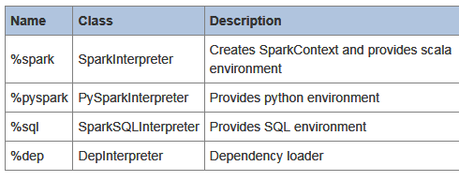
Zeppelin Architecture
Apache Spark is supported in Zeppelin with the Spark Interpreter group, which consists of 4 interpreters
Browser Client
HTTP Rest Websocket
Zeppelin Server
Class Loader
Class Loader
Interpreter Group
Interpreter Group
…
…
Interpreter
Dep
Spark
Spark SQL
Maven
Spark

Slide 28
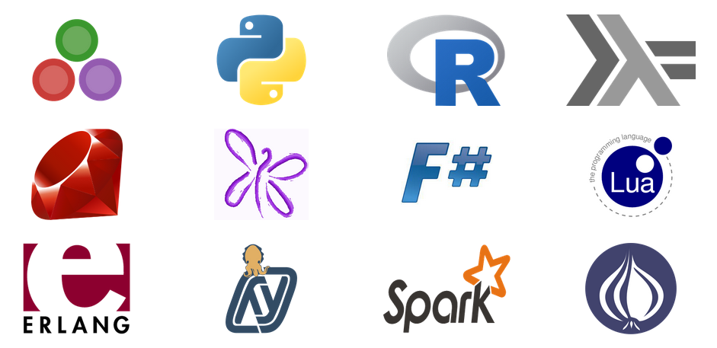
Jupyter
Names inspired by scientific and statistical languages (Julia, Python and R)
Is based on, and an evolution of IPython [Shortly IPython will not ship separately]
Is language agnostic. All languages are equal class citizens. Languages are supported through ‘kernels’ (a program that runs and introspects the users code)
Supports a rich REPL protocol
Includes:
Jupytr notebook document format (.ipynb)
Jupytr Interactive web-based Notebook
Jupyter Qt console
Jupyter Terminal console
Notebook viewer (nbviewer)
Supported languages (Kernels)
See full list here

Slide 29
Spark Streaming
Agenda
Use Cases
How Spark Streaming Works
DStream Abstraction
DStream Operations
Windowing
Guarantees

Slide 30








Stream Processing
Some data lose much of their value if not analyzed within milliseconds (or seconds) of being generated.
Examples: Stock tickers, twitter streams, device events, network signals
Stream processing is about analyzing events in-flight (as it they are streaming by) rather than storing in a database first.
Use cases fro Stream Processing:
Network monitoring
Intelligence and surveillance
Fraud detection, Risk management
E-commerce
Smart order routing
Transaction cost analysis
Pricing and analytics
Algorithmic trading
Data warehouse augmentation

Slide 31
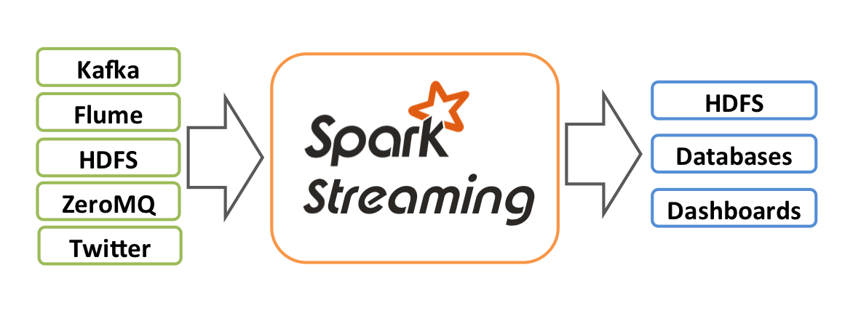
What is Spark Streaming?
Spark Streaming is an extension of the core Spark API that allows enables high-throughput, fault-tolerant stream processing of live data streams
Data can be ingested from many sources like Kafka, Flume, Twitter, ZeroMQ or plain old TCP sockets.
Events can be processed using complex algorithms expressed with high-level functions like map, reduce, join and window.
Processed data can be pushed out to filesystems, databases, and live dashboards.
Can apply Spark’s in-built machine learning algorithms, and graph processing algorithms on data stream

Slide 32
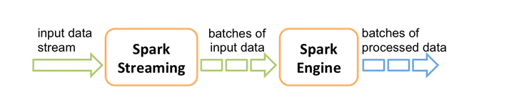
How it works – High level Overview
Spark Streaming receives live input data streams and divides them into (mini) batches called DStreams (discretized streams).
The DStreams are then processed by the Spark engine to generate the final stream of results in batches.
Developing a Spark Streaming application involves implementing callback function that are invoked for every DStream.
The callback function can apply DStream-specific ‘transformations’ on the incoming DStreams.

Slide 33
Core Abstraction: DStream
Discretized Stream or DStream is the basic abstraction provided by Spark Streaming.
Immutable, partitioned, fault-tolerant
Internally, represented by a continuous sequence of RDD. Each RDD in a DStream contains data from a certain interval.
DStream
RDD
RDD
RDD
Data from Time T0 to T1
Data from Time T1 to T2
Data from Time T2 to T3
Any operations applied on a DStream translates to operations on the underlying RDDs. These underlying RDD operations are computed by the Spark engine. DStream operations hide most of these details and provides the developer with higher-level API for convenience
The size of the batch which determines the ‘width’ of the Dstream can be configured

Slide 34
DStream - Operations
Two kinds of DStreams operations—transformations and output operations
Similar to RDD transformations, DStream transformations operate on one or more DStreams to create new DStreams with transformed data.
Examples: map(), flatmap(), repartition(), join(), union(), count(), upDateStateBykey(), …
Output operations write data out to an external data sink, such as a filesystem or a database.
Examples: print(), foreachRDD(), saveAsObjectFiles(), saveAsTextFiles(), saveAsHadoopFiles()

Slide 35
Sample Code
//StreamingContext is the main entry point for all streaming functionality. //First create a StreamingContext with a local master
val ssc = new StreamingContext("local", "NetworkWordCount", Seconds(1))
// Create a DStream that will connect to serverIP:serverPort, like localhost:9999
val lines = ssc.socketTextStream("localhost", 9999)
// Split each line into words using the flatMap function
val words = lines.flatMap(_.split(" "))
// Count each word in each batch val pairs = words.map(word => (word, 1)) val wordCounts = pairs.reduceByKey(_ + _) wordCounts.print()
//When these lines are executed, Spark Streaming only sets up the computation //Processing only starts when the following calls are made call
ssc.start() // Start the computation ssc.awaitTermination() // Wait for the computation to terminate
This scala program prints out the frequency of words in an incoming text stream.
The streams from a socketinput and prints the result to the console
Note that the frequency is counted for each batch
flatMap is similar to map, but each input item can be mapped to 0 or more output items.
The program runs forever waiting for input until terminated

Slide 36
Windowing in Spark
Spark provides a set of transformation that apply to a sliding window of data
A window is defined by two parameters:
Window Length: The duration of the window
Slide interval: The interval at which the window-based operation is performed
Figure below shows window with length = 8 secs and slide interval = 4 secs
First 8 sec Window
Second 8 sec Window
1
2
3
4
5
6
7
8
9
10
11
12
Secs
Window operation is performed here
Window operation is performed here( 4 seconds after the previous one)
“Tumbling window” effect can be achieved by making slide interval = window length

Slide 37
Spark: Window Transformation Operations
Transformation | Meaning
Window (windowLength, slideInterval) | Return a new DStream which is computed based on windowed batches of the source DStream.
countByWindow (windowLength,slideInterval) | Return a sliding window count of elements in the stream.
reduceByWindow (func, windowLength,slideInterval) | Return a new single-element stream, created by aggregating elements in the stream over a sliding interval using func. The function should be associative so that it can be computed correctly in parallel.
reduceByKeyAndWindow (func,windowLength, slideInterval, [numTasks]) | When called on a DStream of (K, V) pairs, returns a new DStream of (K, V) pairs where the values for each key are aggregated using the given reduce function func over batches in a sliding window.
reduceByKeyAndWindow (func, invFunc,windowLength, slideInterval, [numTasks]) | A more efficient version of the above reduceByKeyAndWindow() where the reduce value of each window is calculated incrementally using the reduce values of the previous window. This is done by reducing the new data that enter the sliding window, and "inverse reducing" the old data that leave the window. An example would be that of "adding" and "subtracting" counts of keys as the window slides. However, it is applicable to only "invertible reduce functions", that is, those reduce functions which have a corresponding "inverse reduce" function (taken as parameter invFunc.
countByValueAndWindow (windowLength,slideInterval, [numTasks]) | When called on a DStream of (K, V) pairs, returns a new DStream of (K, Long) pairs where the value of each key is its frequency within a sliding window.

Slide 38
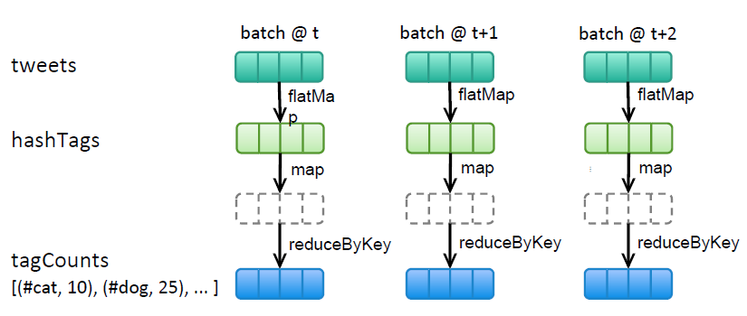
Windowing Sample Code
Count hashtags in twitter stream over last 10 mins, update every 2 seconds
val tweets = ssc.twitterStream<Twitter username>, <Twitter Password>)
val hashTags = tweets.flatMap (status => getTags(status))
val tagCounts = hashTags.window(Minutes(10), Second(2)).countByValue()
Window Operation
Window Length
Sliding Interval
Callback Operation
countByValue() is invoked every 2 secs. All RDDs accumulated in the previous 10 mins is passed to the callback function

Slide 39
“Exactly once”, “At Least Once” Guarantees
Spark provides both exactly once and at least once guarantees.
DStreams, like RDDs are fault-tolerant and can be recomputed from input data source using the lineage.
However, it assumes that the input data is still available to be recomputed. Works if the data source itself is fault-tolerant and persistent (HDFS, Kafka).
If the data stream is delivered over a network (socket stream) then Spark’s default persistence behavior is to replicate data to two worker nodes. Any data received by a node but not yet replicated might be lost when the receiving node fails.
Ensuring exactly once behavior for external updates (such as storing intermediate state in a database) is the responsibility of the application developer. Spark provides no support.

Slide 40
Spark SQL
Agenda
Overview
SQLContext and HiveContext
DataFrames Abstractions
DStream Operations
DataFrame and RDDs
Tables and Queries
Hive Tables

Slide 41

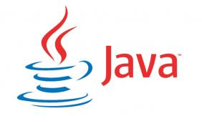

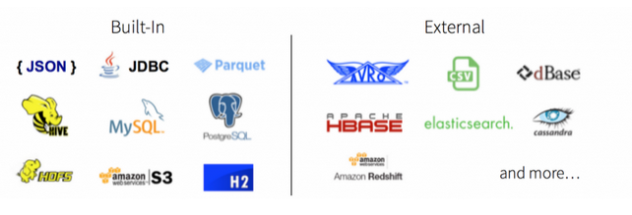
Spark SQL Overview
An extension to Spark for processing structured data.
Part of the core distribution since Spark 1.0 (April 2014)
Is a distributed SQL query engine
Supports SQL and HiveQL as query languages
Also a general purpose distributed data processing API.
Binding in Python, Scala and Java
Can query data stored in external databases, structured data files (eg JSON), Hive tables etc more. [See spark packages for a full list of sources that are currently available]

Slide 42
sqlContext and hiveContext
The entry point into all functionality in Spark SQL is the SQLContext class, or one of its descendants. To create a basic SQLContext, all you need is a SparkContext
>>> val sc: SparkContext // An existing SparkContext.
>>> val sqlContext = new org.apache.spark.sql.SQLContext(sc)
You can also HiveContext instead of sqlContext. HiveContext is only packaged separately to avoid including all of Hive’s dependencies in the default Spark build
HiveContext has additional features:
Write more using the more complete HiveQL parser
Access to Hive UDFs
Read data from Hive Tables
Use the spark.sql.dialect option to select the specific variant of SQL used
For SQLContext the only option is “sql”
For HiveContext the only option is “hiveql”

Slide 43
Core Abstraction - DataFrames
Is a distributed collection data organized into named columns.
Think of them as RDDs with schema
Conceptually equivalent to tables in a relational database or data frames in R/Python
Domain-specific functions designed for common tasks
Metadata
Sampling
Project, filter, aggregation, join …
UDFs
User
User
User
RDDs are collection of ‘Opaque’ objects (i.e. internal structure notknown to Spark)
User
User
User
Name
Age
Sex
Name
Age
Sex
DataFrames are collection of objects with Schema known to Spark SQL
Name
Age
Sex
Name
Age
Sex
Name
Age
Sex
Name
Age
Sex

Slide 44
Creating DataFrames from Data Sources
DataFrames can be created by reading in data from Spark data source, whose schema is understood by spark. Examples include JSON files, JDBC source, Parquet, Hive Tables etc.
>>> val df = sqlContext.jsonFile(”somejasonfile.json“) //from JSON file*
>>> val df = hiveContext.table(”somehivetable“) //from a Hive Table
>>> val df = sqlContext.parquetFile(”someparquetsource“) //from a parquet file
>>> val df = sqlContext.load(source="jdbc", url=“UrlToConnect", dbtable=“tablename")//from JDBC source
*Note that the file that is offered as jsonFile is not a typical JSON file. Each line must contain a separate, self-contained valid JSON object. Regular multi-line JSON file will most often fail.

Slide 45
Creating DataFrames from RDDs
DataFrames can be created from existing RDDs in two ways:
Using Reflection: Infer the schema of an RDD that contains specific types of objects. This approach leads to more concise code. Works well when you already know the schema while writing your Spark application.
Programmatically specifying the schema: Allows you to construct a schema and then apply it to an existing RDD. This method is more verbose. However, allows you to construct DataFrames when the columns and their types are not known until runtime.
DataFrames can be created from existing JSON RDD using the “jsonRDD” function.
>>> val df = sqlContext.jsonRDD(anUserRDD)

Slide 46
DataFrame operations
DataFrames provide a domain-specific language for structured data manipulation in Scala, Java, and Python.
>>> val df = sqlContext.jsonFile(”somejasonfile.json“)
>>> df.show() //show the contents of the DataFrame
>>> df.printSchema() //Print the schema in a tree format
>>> df.select(“name”).show() //select and show the ‘name’ columns
>>> df.select(df(”name”),df (“age”) +1).show() //select all but increment the ‘age’ by 1
>>> df.filter(df(”age”) > 21).show() //select people older than 21
>>> df.groupBy(“age”).count().show() //Count people by ‘age’

Slide 47


Tables and Queries
A Dataframe can be registered as a table which can then be used in SQL queries
// first create a DataFrame from JSON file
>>> val df = sqlContext.jsonFile(”Users.json“)
// register the Dataframe as a temporary table. Temp tables exist only during the lifetime of this instance of SQLContext
>>> val usertable = sqlContext.registerDataFrameAsTable(df, “UserTable”)
//execute a SQL query on the table. The query returns a DataFrame. // This is another way to create DataFrames
>>> val teenagers = sqlContext.sql(“select Age as Years from UserTable where age > 13 and age <= 19”)
jsonFile
DataFrame
registerDataFrameAsTable
sql query
DataFrame

Slide 48
Hive Tables
Spark SQL also supports reading and writing data stored in Apache Hive.
// first create a HiveContext which is derived from SQLContext >>> val sqlContext = new org.apache.spark.sql.hive.HiveContext(sc)
>>> sqlContext.sql("CREATE TABLE IF NOT EXISTS UserTable (key INT, value STRING)")
>>> sqlContext.sql("LOAD DATA LOCAL INPATH ‘user.txt' INTO TABLE UserTable")
//Queries are expressed in HiveQL
>>> val df = sqlContext.sql("FROM UserTable SELECT Name, Age")
Saving to Persistent Tables
When working with a HiveContext a DataFrame can be saved persistently. Persistent tables will still exist even after your Spark program has restarted, as long as you maintain your connection to the same metastore.
saveAsTable() saves the content of the DataFrame to a data source as a table. saveAsTable will materialize the contents of the dataframe and create a pointer to the data in the HiveMetastore.
By default saveAsTable will create a “managed table”, meaning that the location of the data will be controlled by the metastore. Managed tables will also have their data deleted automatically when a table is dropped.

Slide 49
Machine Learning with Spark MLlib
Agenda
Overview
Movie Recommendation Model

Slide 50
What is MLlib?
A collection of machine learning algorithms optimized to run in a parallel, distributed manner on Spark clusters for better performance on large datasets
Seamlessly integrates with other Spark components
MLlib applications can be developed in Java, Scala or Python
Type | Algorithms
Supervised | Classification and Regression: Linear Models (SVMs) logistic regression, linear regression) Naïve Bayes Decision Trees Ensembles of trees (Random Forest, Gradient-Boosted Trees) Isotonic regression
Unsupervised | Clustering: k-means and streaming k-means Gaussian mixture Power iteration clustering (PIC) Latent Dirichlet allocation (LDA)
Recommendation | Collaborative Filtering Alternating least squares (ALS)

Slide 51
Movie Recommendation – Dataset
Will use the publicly available “MovieLens 100k” dataset.
It is a set of 100,000 data points related to ratings given by users to a set of movies
It also includes movie metadata and user profiles. (not needed for recommendation)
The dataset can be downloaded from http://files.grouplens.org/dataset
User Ratings Data (u.data)
Each user has rated several movies and at least one movie
The ratings vary from 1 to 5
The fields in the file (u.data) are tab separated.
Users and movies are identified by Id. More details about the movie and profile of the users are in the other files (u.item and u.user) respectively.
196 | 242 | 3 | 881732314
198 | 302 | 3 | 883894932
22 | 377 | 1 | 883443433
145 | 51 | 2 | 886570342
187 | 356 | 4 | 885634452
166 | 63 | 5 | 886554545
User Id
Movie Id
User’s Rating
Timestamp

Slide 52

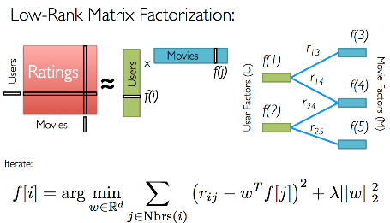
Train the Model
// first read the ‘u.data’ file
>>> val rawData = sc.textFile(“/PATH/u.data”)
// extract the first 3 fields as we don’t need the timestamp field >>> val rawRatings = rawData.map(_.split(“\t”).take(3))
//import the ALS model from MLlib
>>> import org.apache.spark.mllib.recommendation.ALS
//call the train method on the ALS model. The train method needs a RDD that consists of Ratings records.
// A Rating class is a wrapper around user id, movie id and the ratings arguments.
// Create the ratings dataset using the map and transforming the array of IDs and ratings into a Rating object.
>>> val ratings = rawRatings.map { case Array(user, movie, rating} =>Rating(user.toInt, movie.toInt, rating.toDouble)}
//call the train method. It takes three parameters:
// 1) rank – The number of factors in the ALS model. Between 10 and 200 is a reasonable number // i2) iterations – Number of iterations to run. ALS models converge quickly. 10 is a good default
// i3) lambda – controls regularization (over-fitting) of the model. Number is determined by trial and error. Use 0.01
>>> val model = ALS.train(ratings, 50, 10, 0.01)
//We now have a MatrixFactorizationModel object
Train
Trained ALS Model

Slide 53
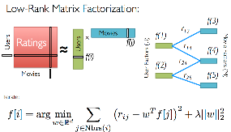

… Make Recommendations
// Now that we have the trained model, we can make recommendations
// Get the rating that used 264 will give to movie 86 by calling the predict method
>>> val predictedRating = model.predict(264, 86) → 3.8723214234
//the predict method can also take an RDD of (user, item) IDs to generate predictions for each.
// Can generate the top-N recommended movies for an user, with the recommendProducts method.
//recommendProducts takes two parameters: user ID and number of items to recommend for the user.
//The items recommended will be those that the user has not already rated!
>>> val topNRecommendations = model.recommendProducts(564, 5)
>>> println(topNRecommendations.mkString(“\n”))
//will display the following on the console (user id, movie id, predicted rating)
Rating( 564, 782, 5.983324324324)
Rating( 564, 64, 5.974354545454)
Rating( 564, 581, 5.863424242444)
Rating( 564, 123, 5.763243434344)
Rating( 564, 8, 5.639434324348)
User Id
recommendProducts()
List of Recommended Movies

Slide 54
Recommender Performance Evaluation
There are multiple ways of evaluating the performance of a model
MLlib has built-in support for Mean Square Error (MSE), Root Mean Square Error(RMSE) and Mean Precision Average at K (MAPK) in the RegressionMetrics and RankingsMetrics classes.
Here’s the code for RMSE and MSE:
// starting with ‘ratings’ from the previous slide: Extract the user and product IDs from the ratings RDD and call
// model.predict() for each user-item pair.
>>> val usersProduct = ratings.map { case Rating(user, product, ratings) => (user, products) }
>>> val predictions = model.predict(userProducts).map { case Rating(user, product, rating) = { (user, product), rating) }
//create an RDD that combines the actual and predicted ratings for each user-item combination
>>> val ratingsAndPredictions = ratings.map { case Rating(user, product, rating) => ((user, product), rating) }.join(predictions)
//create an RDD of key-value pairs that represent the predicted and true values for each data point
>>> val predictedAndTrue = ratingsAndPredictions.map{ case ((user, product), predicted, actual)) => (predicted, actual)}
//Calculate RMSE and MSE Regression Metrics
>>> import org.apache.spark.mllib.evaluation.RegressionMetrics
>>> val regressionMetrics = new RegressionMetrics (predictedAndTrue)
// Mean Squared Error = regressionMetrics.meanSquaredError
//Root Mean Squared Error = regressionMetrics.rootMeanSquaredError

Slide 55
Spark with Azure HDInsight
Agenda
Provisioning HDInsight Spark Clusters
Azure Portal Integration
Scripting
Managing HDInsight Spark Cluster
Developing and running HDInsight Spark Applications
Jupytr Notebook
Zeppelin Notebook
Spark Shell
Stand-alone Scala Programs
HDInsight integration with Azure Event Hubs

Slide 56
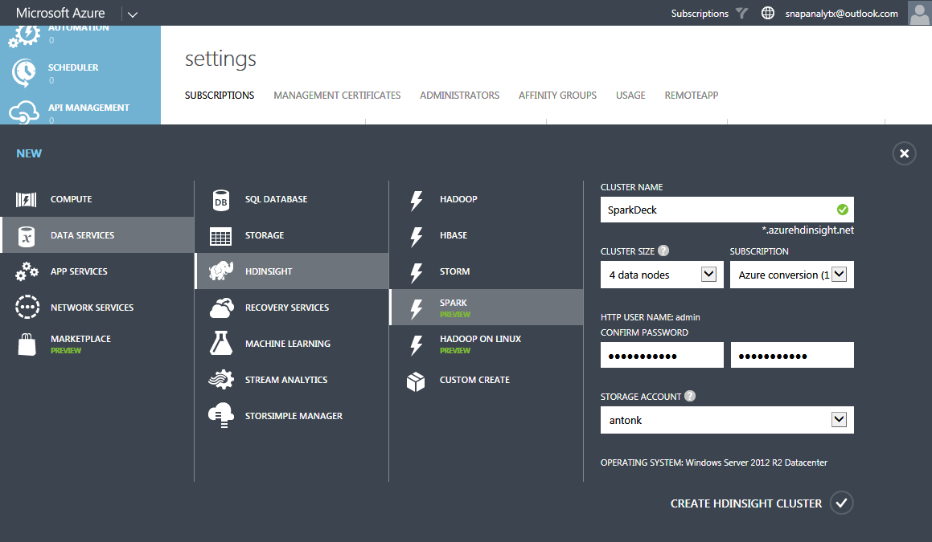
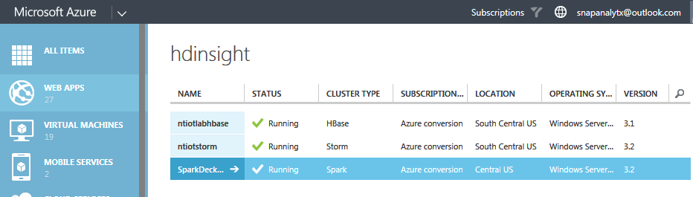
Creating a HDInsight Spark Cluster
A Spark cluster can be provisioned directly from the Azure console.
Only the number of data nodes have to be specified (can be changed later)
Clusters can have up to 16 nodes
More nodes enable more queries to be run concurrently
The Azure console lists all types of HDInsight clusters (HBase, Storm, Spark etc) currently provisioned

Slide 57
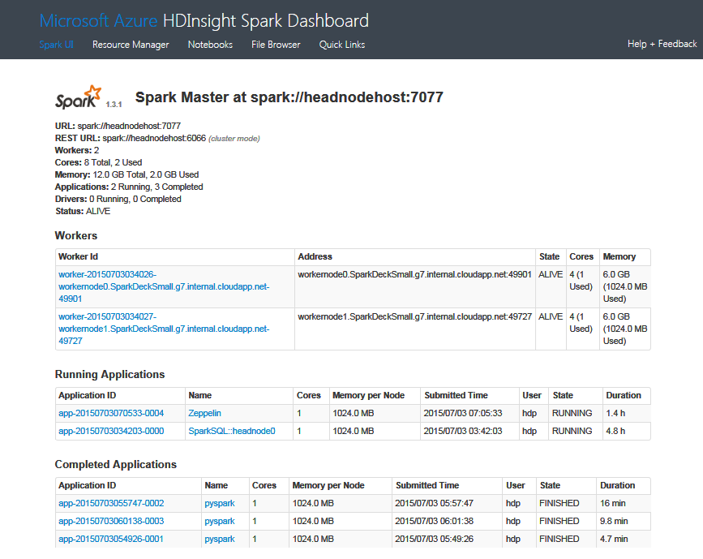
HDInsight Spark Dashboard
The HDInsight Spark Dashboard provides links to access:
The Spark UI (the web-based UI to monitor a Spark cluster)
The Resource Manager that controls the amount of resources allocated to various Spark cluster components
Notebooks – interactive web based tools to develop and run Spark programs

Slide 58
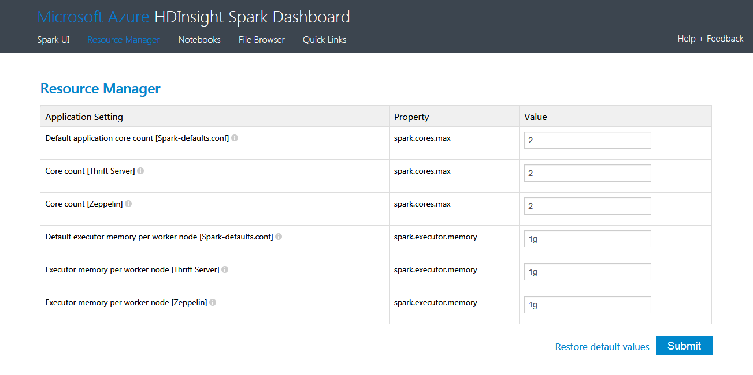
HDInsight Spark Resource Manager
The Resource Manager enables you to control the number of cores and amount of memory allocated to Spark cluster components and notebooks.
Increasing the resources allocated to the Thrift Server can potentially improve the performance with BI Tools

Slide 59
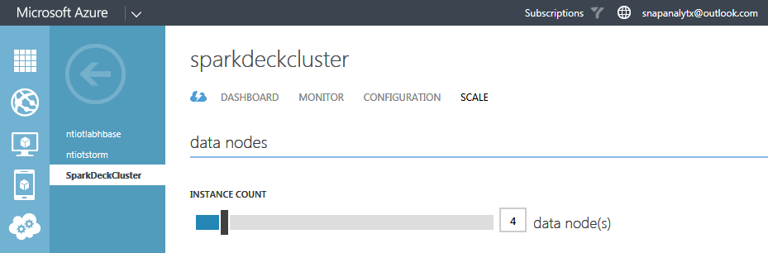
Resizing a HDInsight Spark Cluster
Like other HDInsight cluster types, the number of nodes in a Spark cluster can be increased dynamically
The cluster or the running jobs do not have to be paused or stopped to resize
Note: Performance of queries can also be improved by caching data in memory or SSD

Slide 60

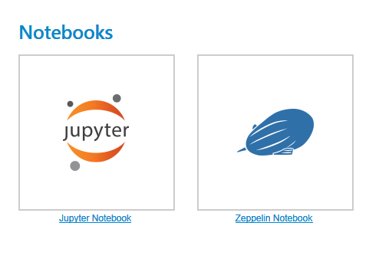
Notebooks: Jupyter and Zeppelin
HDInsight Spark supports two notebooks: Jupyter and Zeppelin
The links to notebooks are available on the Dashboard
The notebooks are pre-installed and can be launched by just clicking on the links. No other setup is required such as launching any background services. HDInsight Spark will start the Jupytr Kernels or Zeppelin Servers
The notebooks belong to a subscription and are persistent across clusters. They will not be any or all Spark cluster are shutdown.

Slide 61
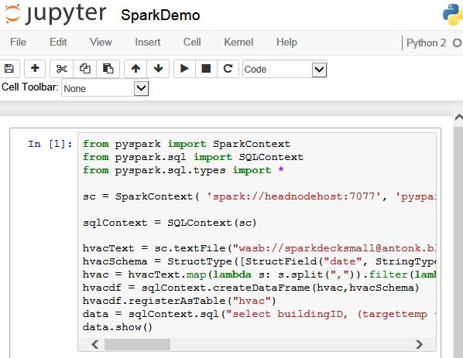

HDInsight Spark: Jupytr Notebooks
A Jupyter notebook showing a Spark program in Python 2
You can select a particular cell and execute it by either entering Shift+Enter or clicking on the icon. All the cells can be selected to run as well. Clicking on the icon stops the execution
You can Interrupt, Restart or Reconnect to a running kernel.
You can also connect to a different kernel (however, currently only Python Kernels are available)
Notebooks can be duplicated or renamed.
While editing you can save and checkpoint the changes and revert back to a checkpoint.
On the main Jupytr console page, you can see the list of notebooks, the list of running notebooks

Slide 62
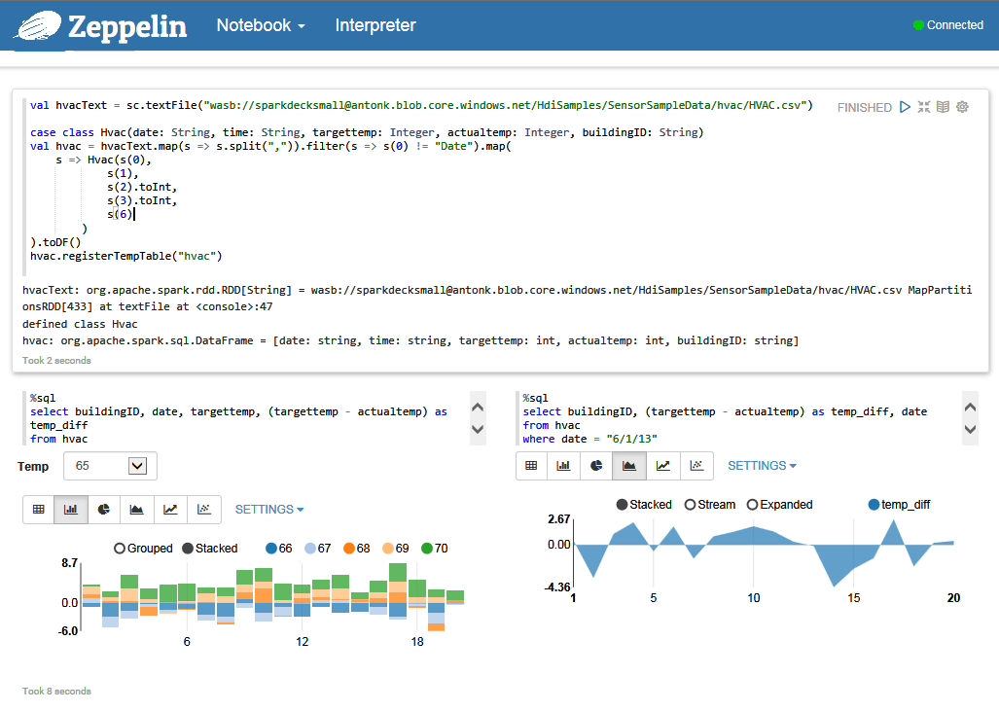
HDInsight Spark: Zeppelin Notebooks
Zeppelin notebook must be connected to a Spark cluster to run
A notebook ‘paragraph’ can be executed by clicking this icon
Like Jupytr, Zeppelin enables interactive charts and graphs to be easily included in a notebook.
You can control the visualization using the “Settings” drop-down menu
A number of charts and graphs are already built into the Zeppelin notebook

Slide 63

Machine Learning with Anaconda
Anaconda is a free, enterprise-ready Python distribution for large-scale data processing, predictive analytics, and scientific computing
It include 330+ of the most popular Python packages for science, math, engineering, data analysis
Anaconda is installed as part of HDInsight Spark. The libraries will be updated at a regular cadence

Slide 64
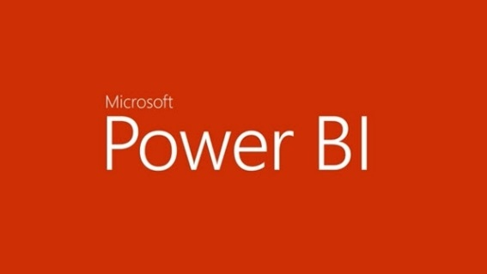



Streaming with Azure Event Hub
HDInsight Spark Streaming integrates directly, out-of-the-box, with Azure Events
HDInsight Spark Streaming applications can be authored using Zeppelin notebooks or other IDEs
Event hub watermark is saved such that you can start your streaming job from where you left it
The output of Streaming can be directed to Power BI
Azure Event Hub
HDInsight Spark Streaming
Power BI

Slide 65
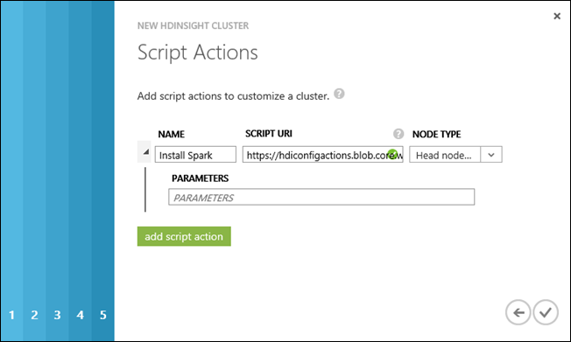
Creating HDInsight Spark with Script Actions
You can install Spark on a HDInsight cluster using Script Actions using the Wizard
Script Actions are a generic mechanism to install custom software while HDInsight clusters are being provisioned.
A default script is already provided at: https://hdiconfigactions.blob.core.windows.net/sparkconfigactionv03/spark-installer-v03.ps1
By default the script installs:
Spark 1.2.0 on HDInsight 3.2 clusters
Spark 1.0.2 on HDInsight 3.1 clusters
Spark requires no additional parameters

Slide 66
Interactive Queries with Spark Shell
From the Azure portal, enable Remote Desktop for the cluster you created with Spark installed, and then remote into the cluster.
In the Remote Desktop Protocol (RDP) session, from the desktop, open the Hadoop command line and start the Spark shell: .\bin\spark-shell --master yarn
After the command finishes running, you should get a Scala prompt: scala>
On the Scala prompt, enter the Spark query shown below. This query counts the occurrence of each word in the davinci.txt file that is available at the “/example/data/gutenberg/” location on the Azure Blob storage associated with the cluster.
val file = sc.textFile("/example/data/gutenberg/davinci.txt")
val counts = file.flatMap(line => line.split(" ")).map(word => (word, 1)).reduceByKey(_ + _) counts.toArray().foreach(println)
You should see the output on the console
Type :q to quit the scala session

Slide 67
Stand-alone Scale Programs
Write a Scala program that defines an object called “MyTestApp” and save in “MyTestApp.scala”
Build the program with Simple Build Tool (sbt)
Install sbt from: http://www.scala-sbt.org/0.13/tutorial/Installing-sbt-on-Windows.htm
Copy “MyTestApp.scala” to “MyTestApp\src\main\scala”
Navigate to “MyTestApp\src\main\scala”
Run from command prompt: sbt package
On completion “mytestapp_2.10-1.0.jar” file is created in MyTestApp\Target\
Remote to the Spark cluster
Copy “mytestapp_2.10-1.0.jar” file over
Run from command prompt: c:\apps\dist\spark-1.2.0\bin\spark-submit –class “MyTestApp” –master local mytestapp_2.10-1.0.jar
The results should be displayed on the console

Slide 68
Running and Managing Queries/Jobs
You can use REST APIs to manage Jobs:
Submit Spark Jobs
Cancel Spark Jobs
Get Job Status
You can run concurrent queries against the same Spark cluster:
The concurrent queries can be run from single app or multiple app
A blocking call from one query should not impact other queries
The number of supported concurrent queries will depend on the size of the cluster. On average HDInsight Spark will support 1 query per node (ex: 8 node will support 8 concurrent queries)

Slide 69
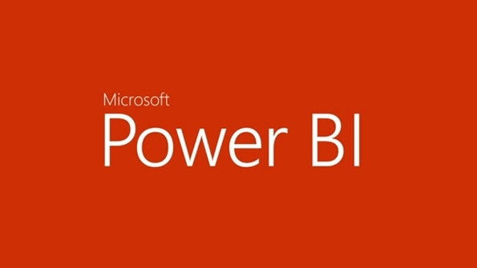
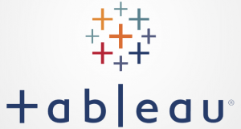


Integration with BI Reporting Tools
HDInsight Spark integrates with these BI tools to report on Spark data

Slide 70
Get started today!
For more information visit: http://azure.microsoft.com/en-us/services/hdinsight/

